Slide 1
MAUG DataOps 22/04/2020
Dave Lusty

Slide 2
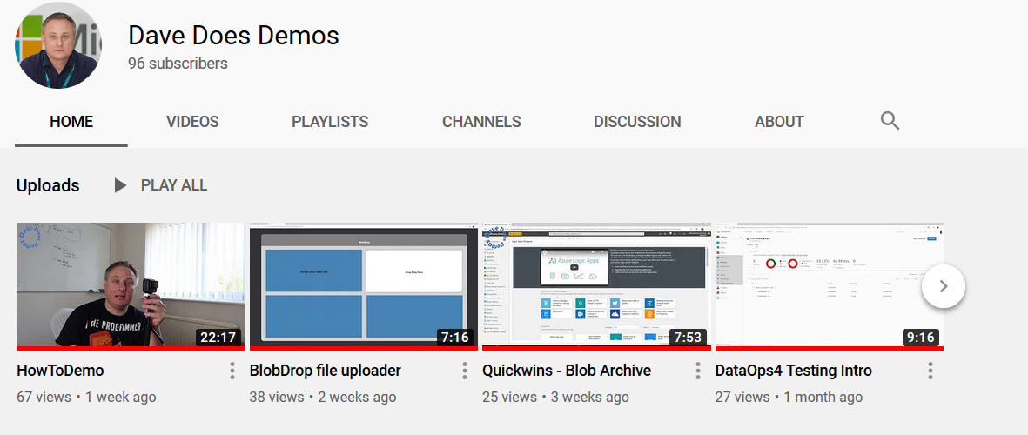

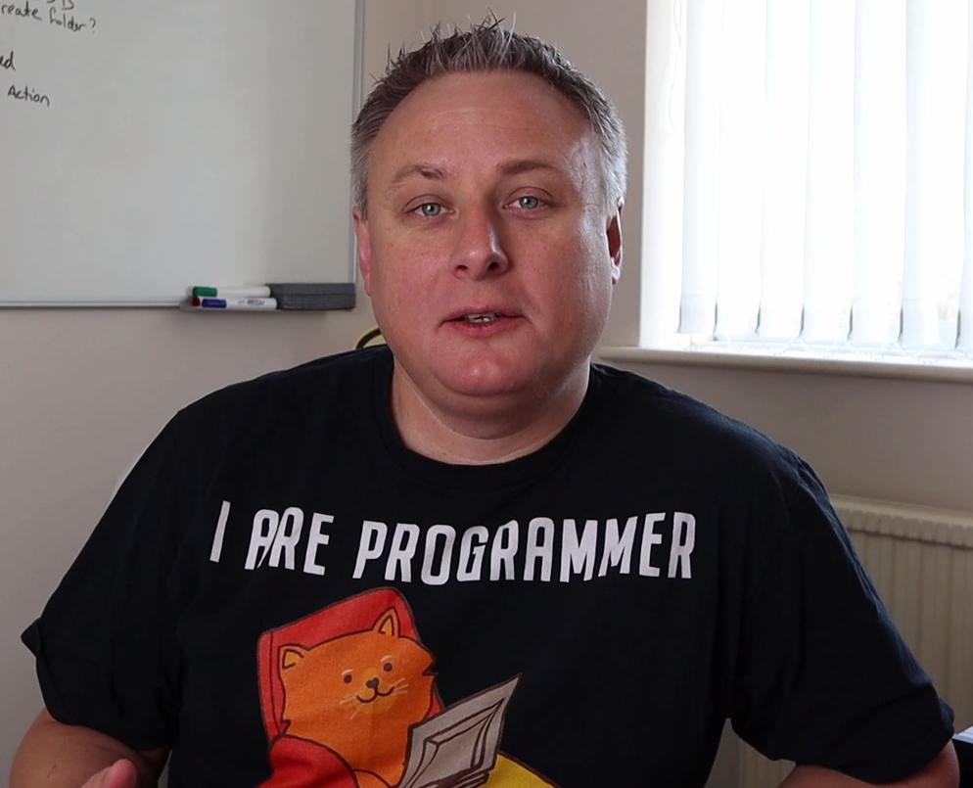
Cloud Solution Architect (Data & AI)
(formerly AD, Delphi, Desktop, Linux, UNIX, Citrix, Exchange, SQL Server, VMWare, Hyper-V, SAN, Networking, DevOps, AWS, C#)
aka.ms/davedoesdemos aka.ms/demotube
Aka.ms/datalakeinaday

Slide 3
What?
DataOps for modern data platforms
Orchestrator (Data Factory)
Processor (Spark)
Store (ADLS)
Presentation (SQL DW)
Connections
Data Sets
Pipelines
Libraries
Jobs
Scripts
Triggers
Structure
Governance
Loading

Slide 4
Why?
Different way of working
Building Things
Not just automation or scripting
Consistency
Velocity
Quality
Control
No change control!

Slide 5
Concepts
Artifact
Build Pipeline
Release Pipeline
Environment
Immutable
Includes everything needed to deploy
Always CREATES an artifact
Always DEPLOYS an artifact
To an environment
A target system where the artifact is deployed
i.e. Production data factory
Sometimes compiles code, sometimes copies things

Slide 6
Testing
Unit Test
Integration Test
Generally in Build pipeline
i.e. function in Python library
Input vs output
Generally in Release pipeline
i.e. ADF pipeline using Python library in Spark
Input vs output
Known bad data input
Known good data input
Do lookups work as expected?
Boundary conditions (i.e. times in am/pm 24h vs 12h)
Are files where expected?
Is all expected data present
Tests specific thing
Tests wider systems
Generated data set designed around testing

Slide 7
Environments
Development
Test
Production
(Pre-Production)
Development takes place here
May be a laptop
May be a web service
Designed for tests
No human interaction where possible
Automated tests
Usually not needed
Just confirms no deployment issues
End user environment
No human admin ideally
Data - Generally a generated but representative data set (i.e. the right schema but not real data)
Who – Data engineers, developers
Who – Nobody, results report back to Azure DevOps for approval
Data – Generally a dataset architected around tests. Not necessarily same schema, definitely not real data, as small as possible to carry out testing
Data –This will use the production lake
Who – Early access users
Who – Everyone including analysts EXCEPT data scientists
Data – Production lake
Usually product specific
Usually process specific “end to end”

Slide 8
Special Environments
Experimental
For Data science
Separated for performance reasons
Data – Generally copied to another lake as needed
Removed as soon as possible
Who – Data scientists
Not development
Experimentation
Less governance

Slide 9
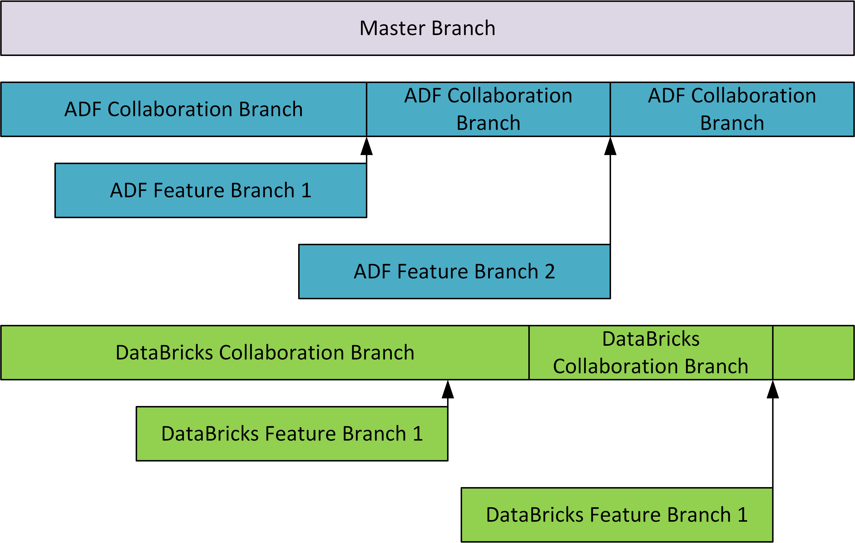
Code Branching

Slide 10
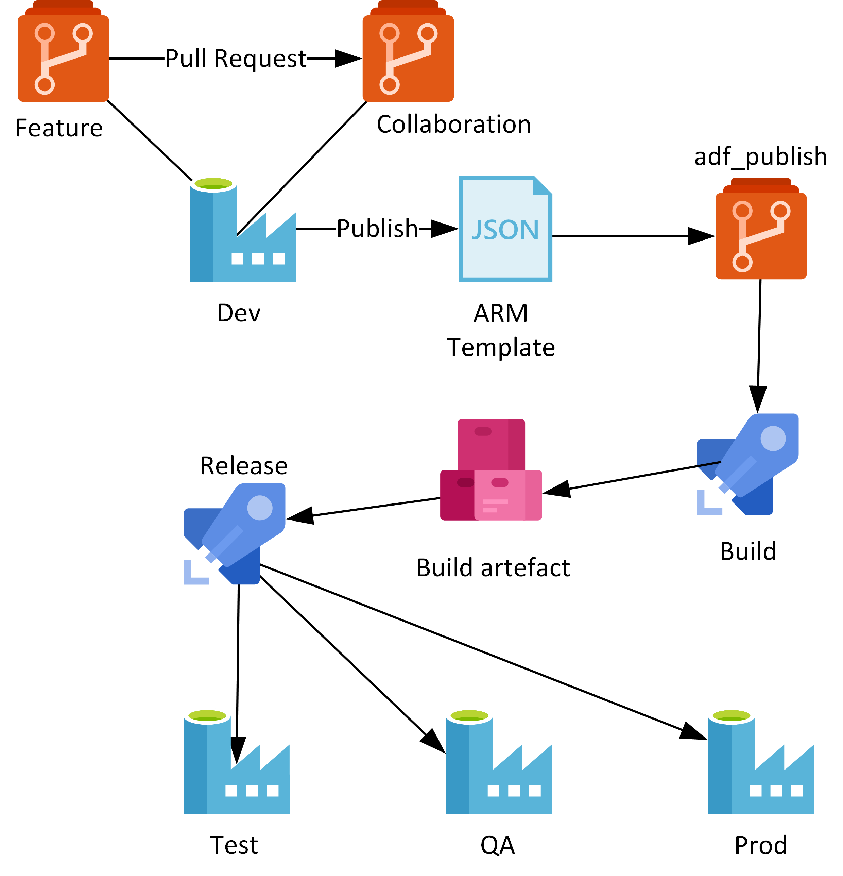
Demo
Work on features
Deploy to environment
Set up for testing
In case there’s not enough time…
https://github.com/davedoesdemos/ DataDevOps/blob/master/Data_Factory/ ADFDevOps.md
https://youtu.be/CW5GXIEhePE

